Slide 1
IN THE FRAMEWORK OF THE AMERICAN SPACES PROGRAM INITIATED BY THE U.S. STATE DEPARTMENT

Slide 2
Who are we?
American Spaces are U.S. State Department operated or supported public diplomacy facilities,
providing digitally enhanced physical platforms for effective engagement with foreign (Hungarian) audiences in support of U.S. foreign policy objectives, cultural and educational initiatives.

Slide 3
American Spaces Around the World
The American Spaces Program and its budget is approved by the U.S. Senate and the material of the program is set out by the U.S. State Department, which focuses on culture and education in 154 countries in the world with more than 700 offices. These offices can be set up in two different ways; either in properties owned by the U.S. government or within partner institutes, which are most commonly universities or libraries.
On average, around 60 million people participate in the 2,5 million programs that are created by the American Spaces offices around the world.
By creating these programs, the United States strives to create a platform that provides information and skills with the help of modern technology for the potential leaders, innovators and businesspeople of the future in the digital age.

Slide 4
Program Objectives
American Spaces provide public diplomacy programming designed to attract and engage audiences in open, participatory dialogue and hands-on activities.
They are designed, configured, and equipped to promote critical thinking, innovation, and thoughtful discussions of issues important to the U.S. relationship with the host country and U.S. global interests.
American Spaces programming showcases the breadth and depth of American values, ideals, culture, and perspectives on a variety of themes.

Slide 5
Core Focus
Educational advising and promoting study in the United States (EducationUSA)
Cultural and outreach programs; Information about the United States
English language practice
Alumni networking, projects, and activities

Slide 6
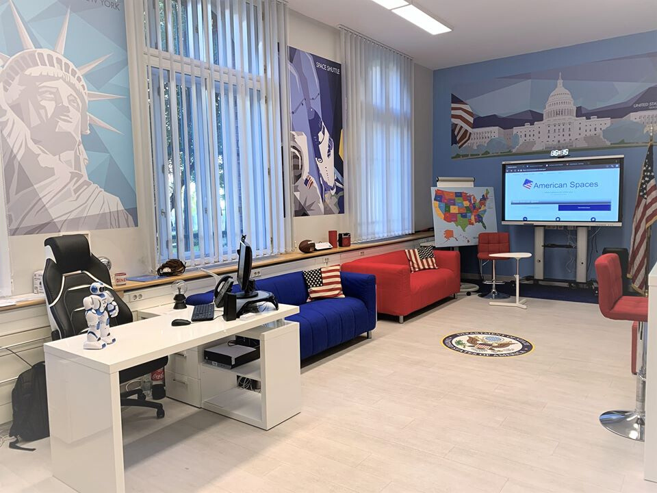

Slide 7
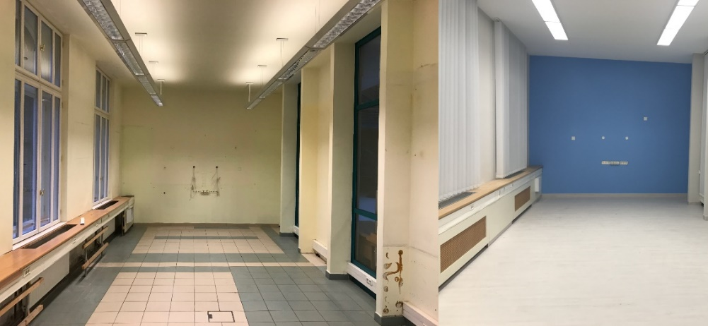
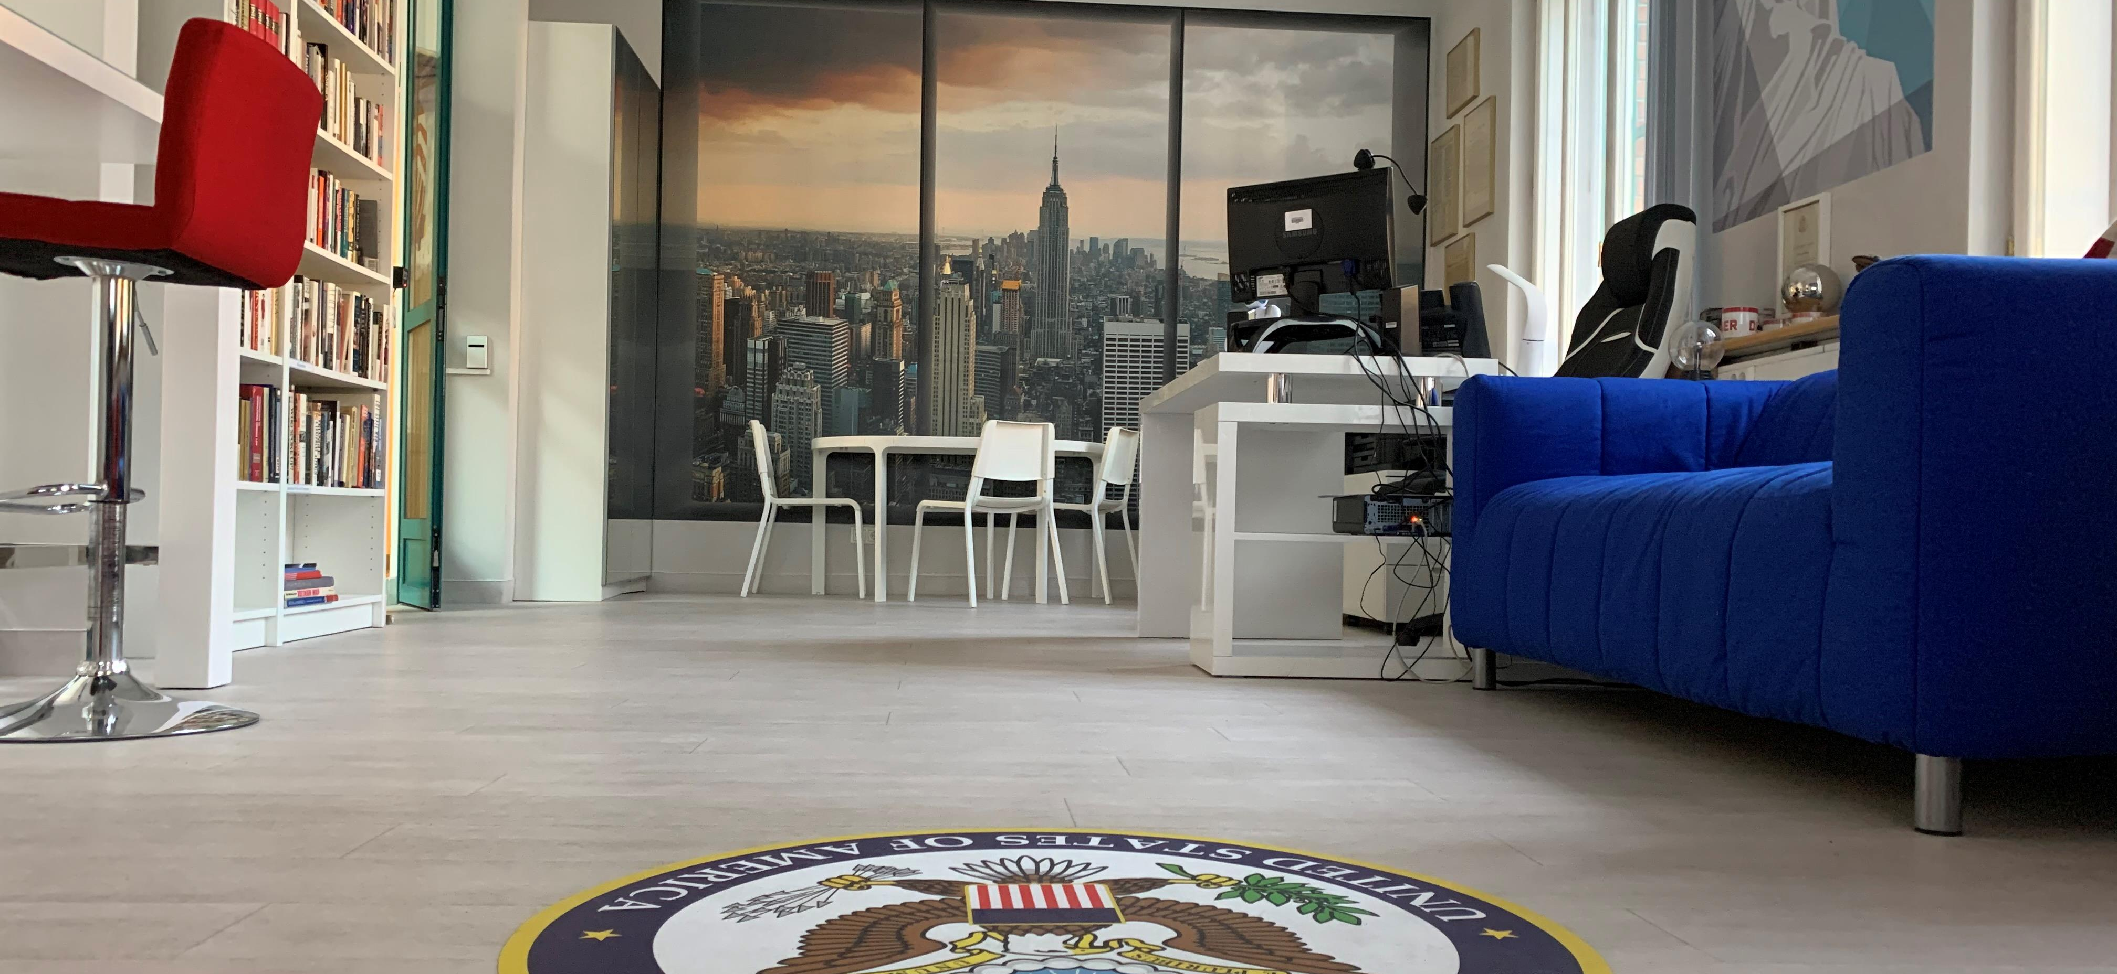
REMODELLED SPACE
WITH INNOVATIVE DESIGN
The remodeling of the American Spaces Budapest center at Corvinus University’s campus started in 2019 led by newly appointed director, Ferenc Maurer. In the process, the Budapest center was stripped from its old design to its basic structure, and it was given new flooring and paneling. In addition, the room was decorated with window stickers, and modern, energy efficient, LED lights, as well as air-conditioning.
The new multi-functional user interface is easy and fast to transform based on what a given event requires. In addition to the modern furniture, high-tech devices were installed at the center, such as a 4K UHD LED touchscreen interactive board, a MarkerBot 3D printer with FFD technology, Apple MacBook Pro and Air laptops, iPads, Chromebook laptops, and programmable educational robots etc.
Following re-opening of the Space the public are welcomed to join the free, skill-based, educational program series, created in line with the challenges of the digital age. These programs can be presentations, interactive discussions and workshops. Among the programs there are Public Speaking, Debate, Essay Writing, Digital Literacy, CV Writing, Video Editing and 3D Printing workshops, as well as weekly Conversation Clubs, language exam prep courses, information about American scholarships and summer work.

Slide 8
ACTIVITIES AT THE AMERICAN CORNER
English Learning and Conversation Clubs
TOEFL Exam and Writing Workshops
Introduction to 3D Printing Workshops
Activities Organized by US alumni
Presentations Held by Fulbright Scholars
Current US Political/Economic Analysis by Experts and Scholars
Highschool Outreach Programs
Media Literacy Workshop
Public Speaking and Improvisation Workshops
Summer University and Camp Activities
For further information about these events, please contact us.

Slide 9
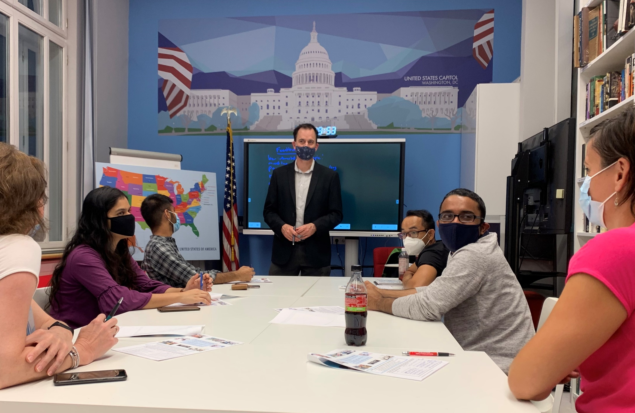
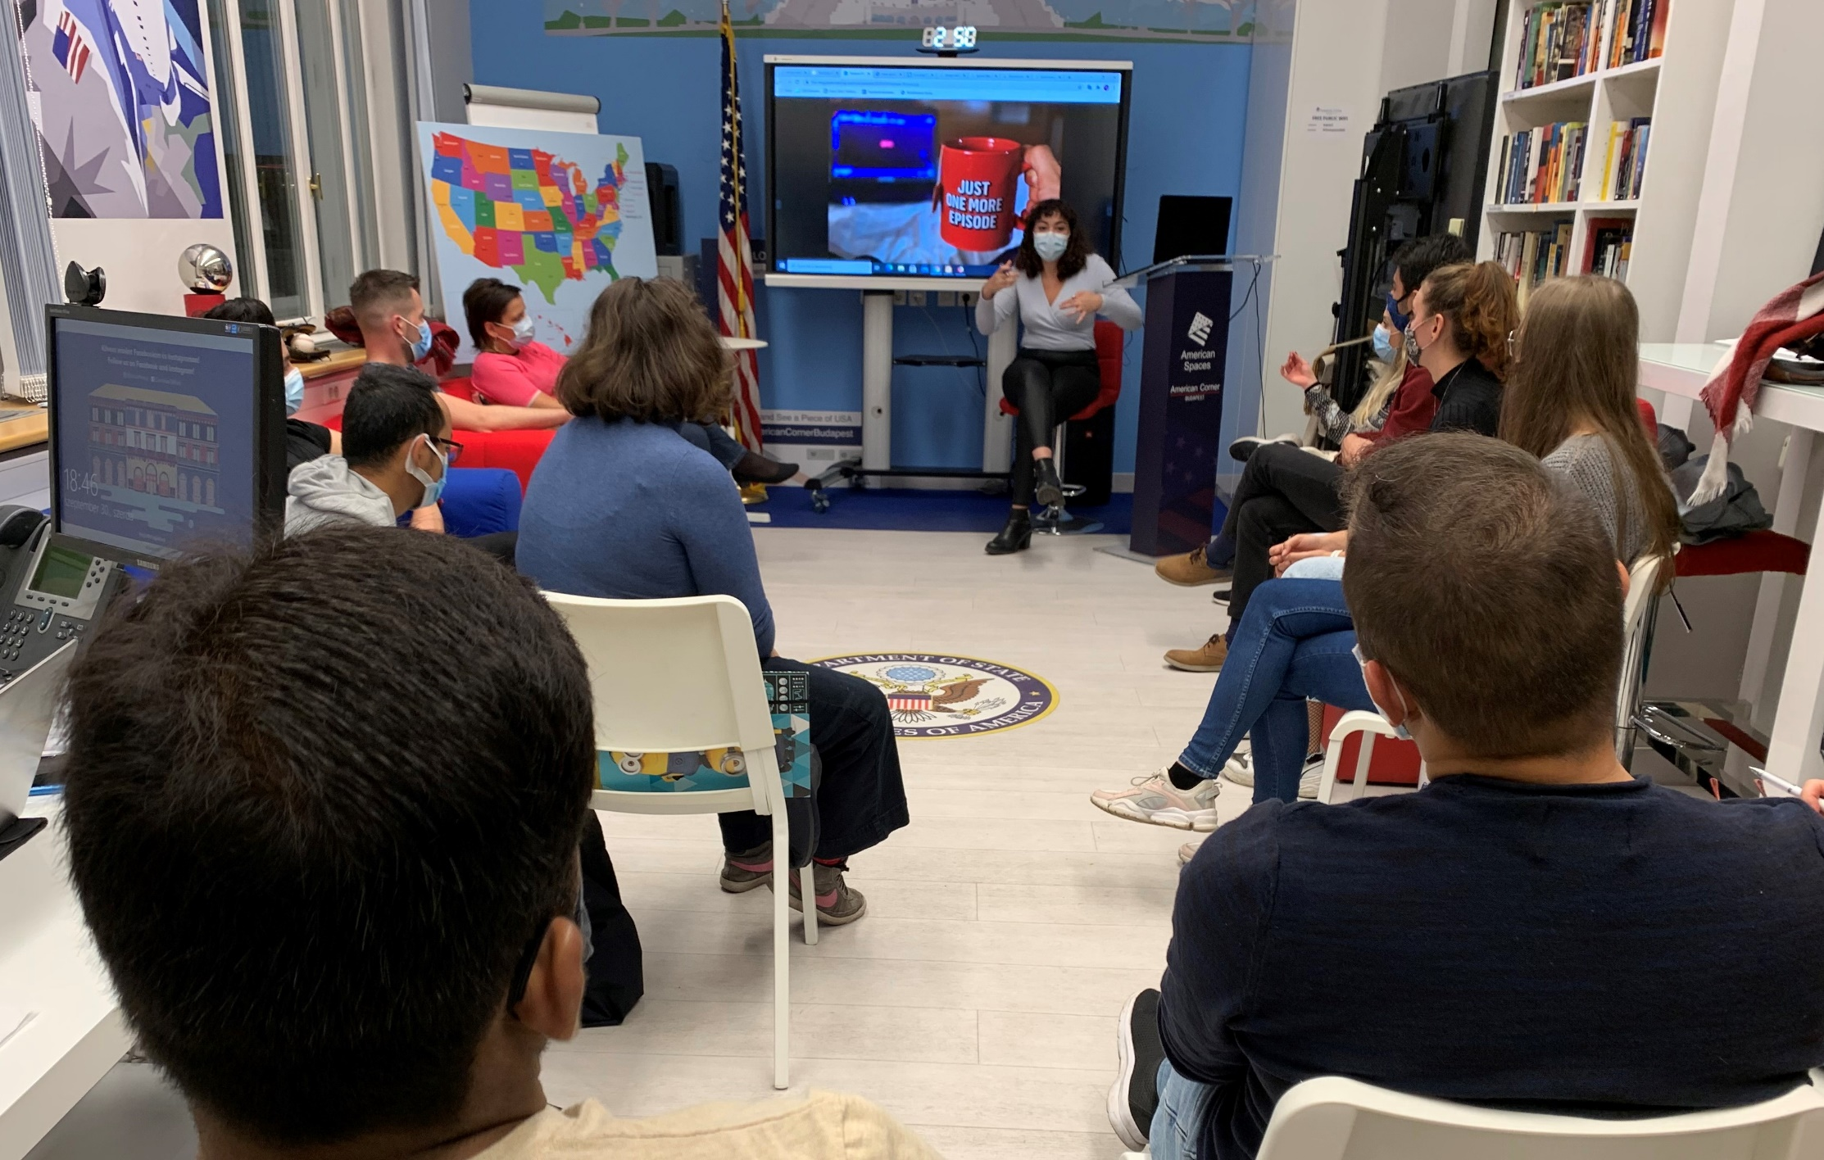
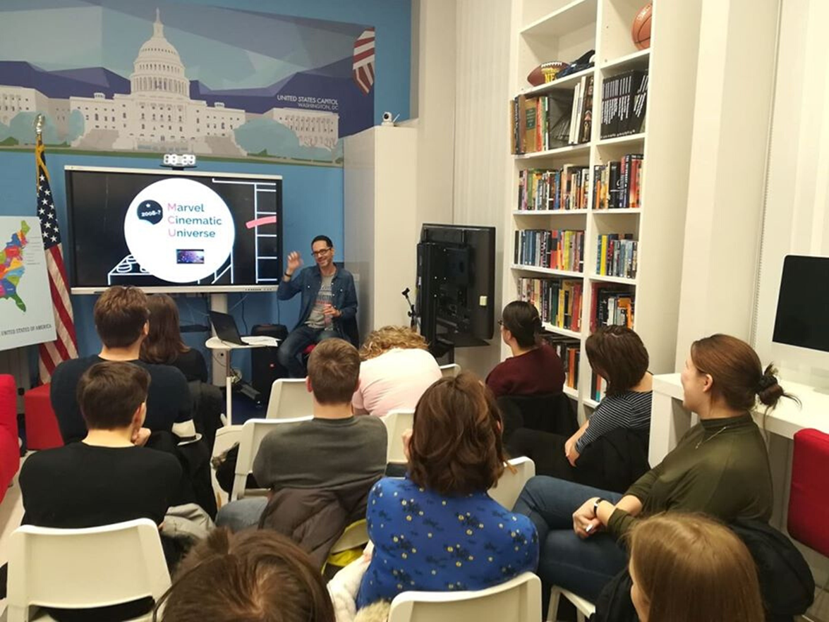
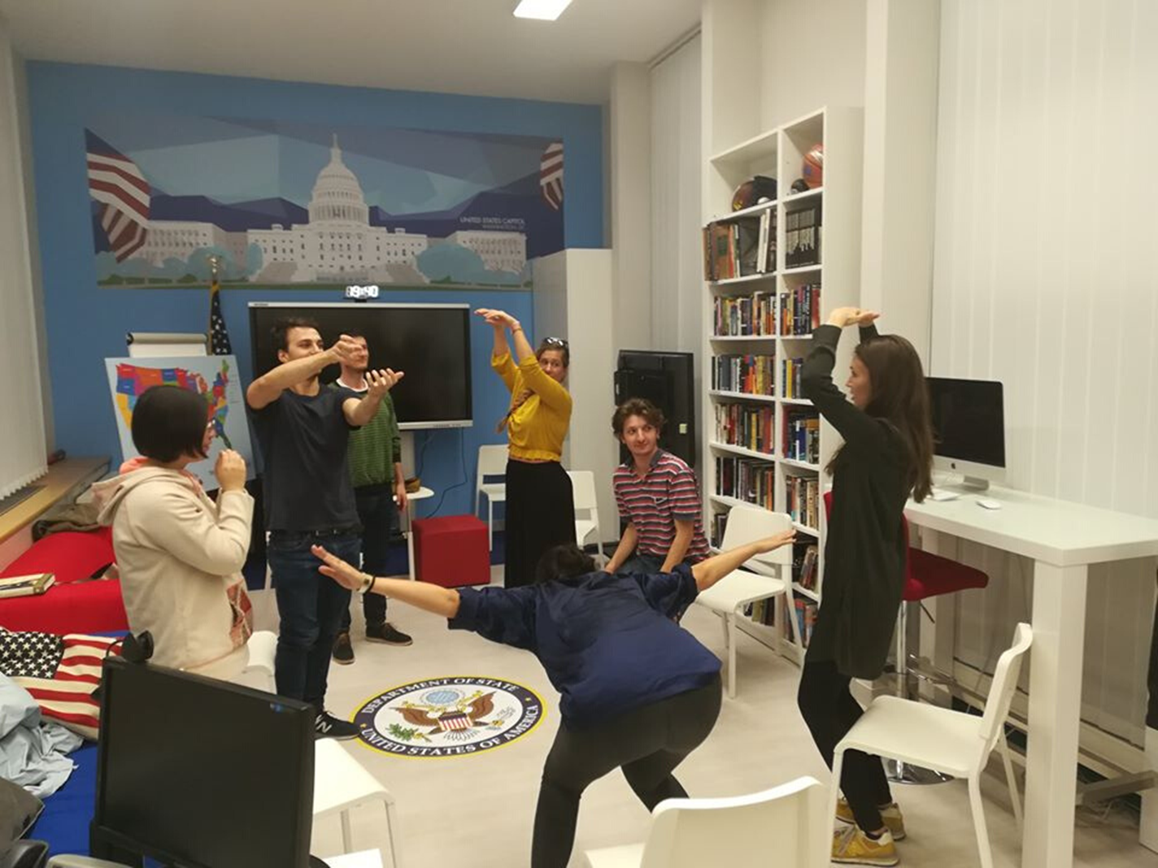
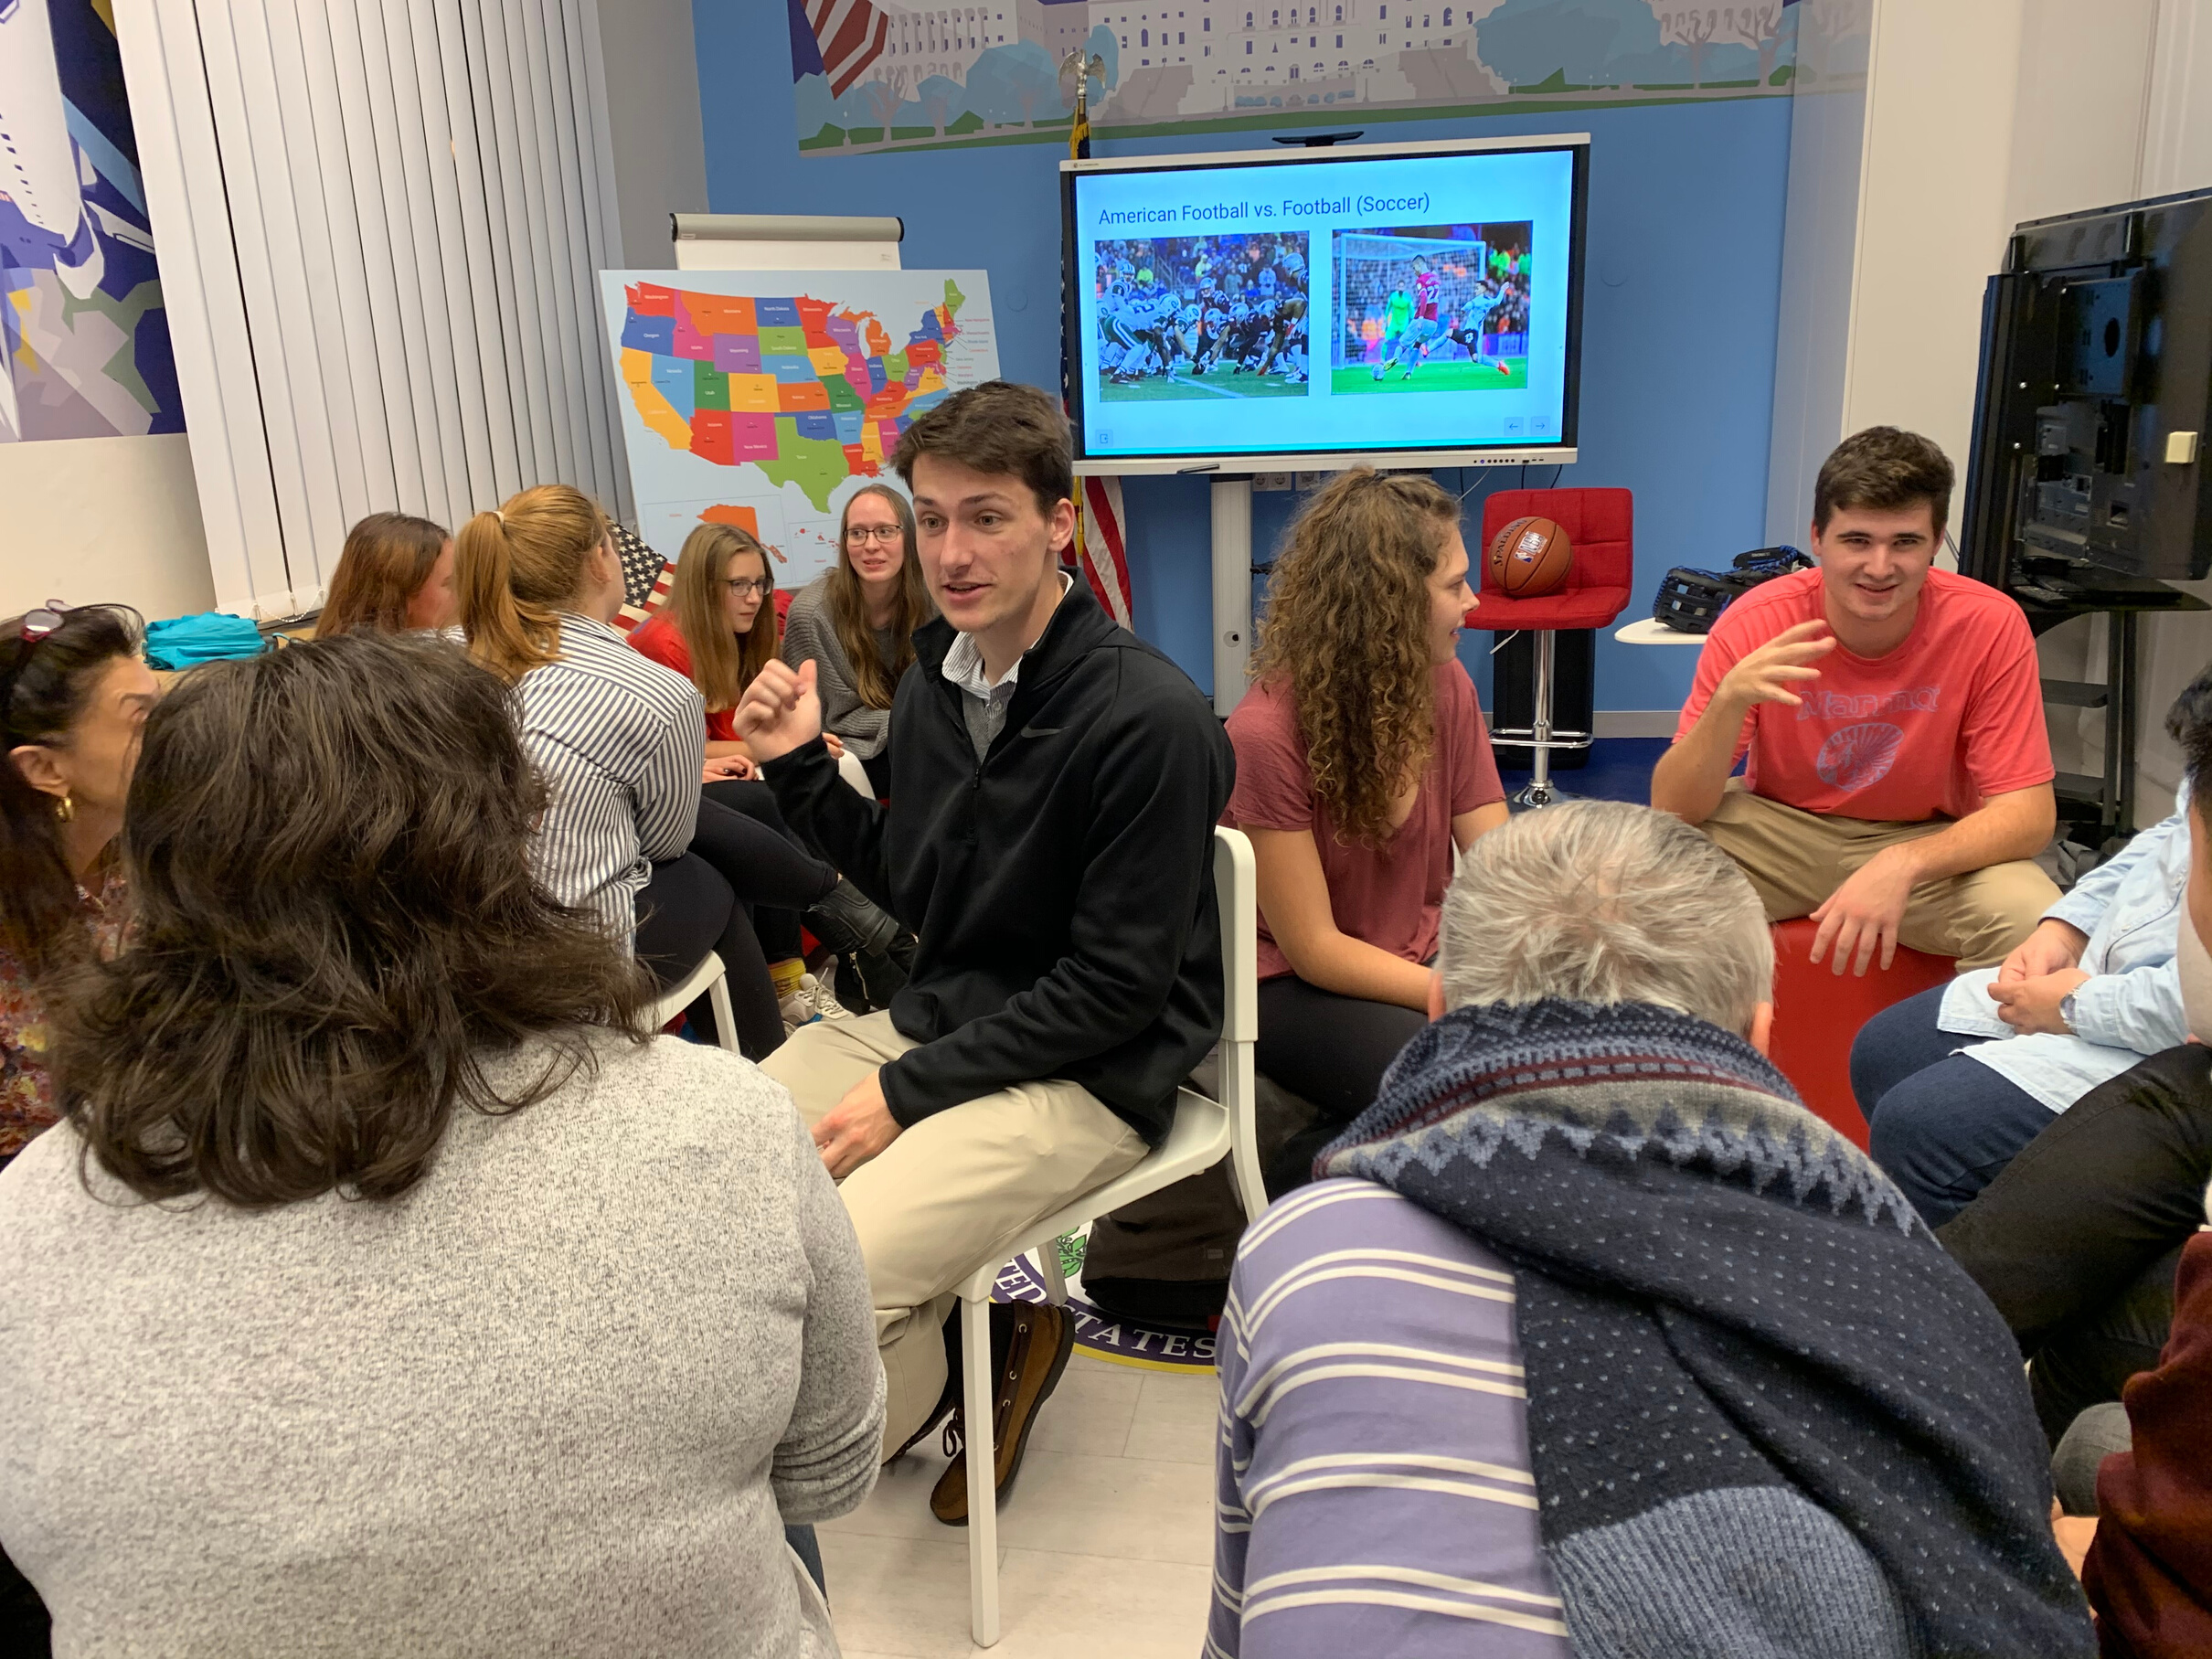

Slide 10
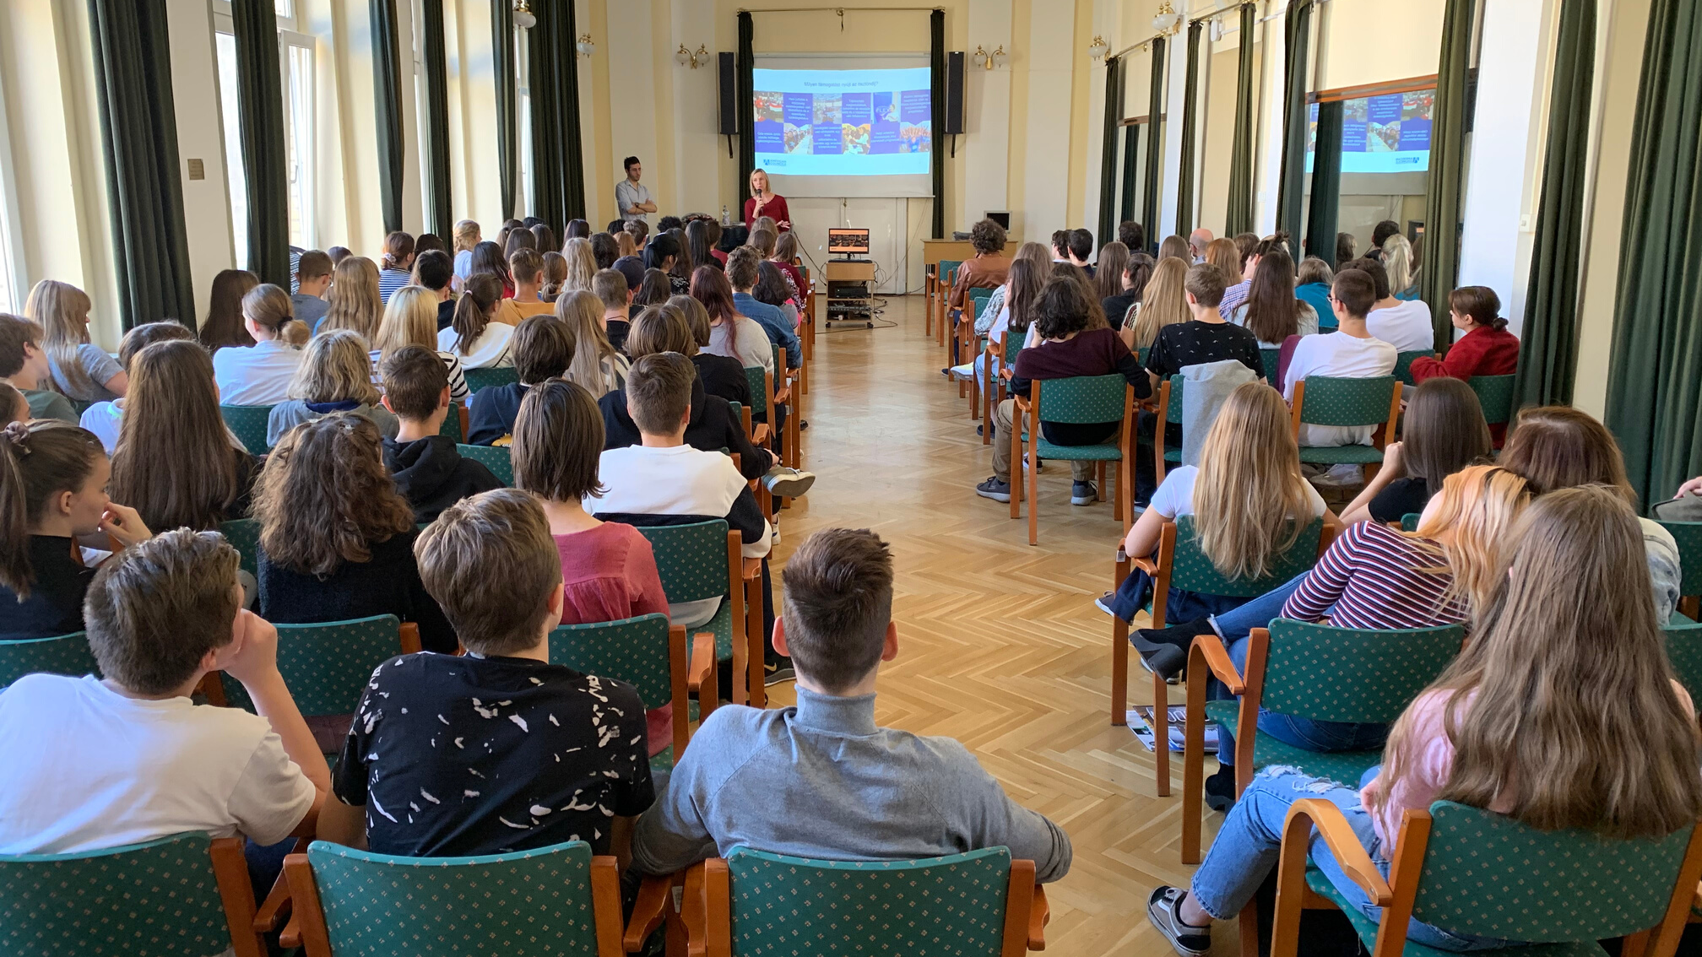
High School Outreach and Educational Orientation Programs

Slide 11
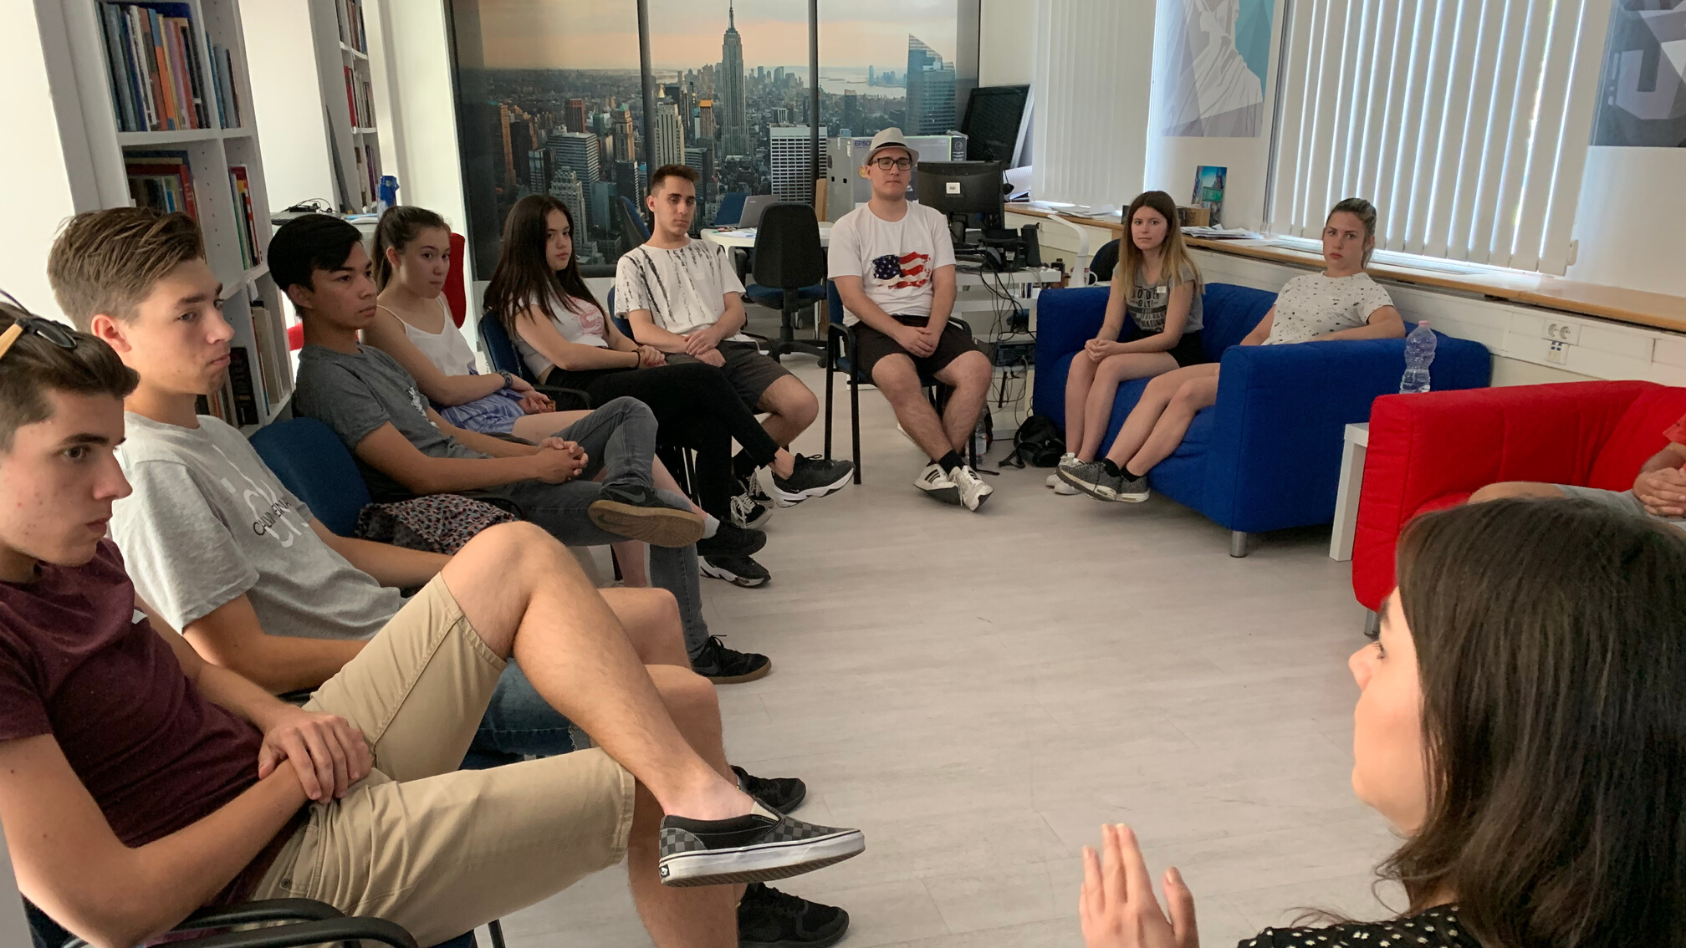
Summer University and Camp Activities

Slide 12
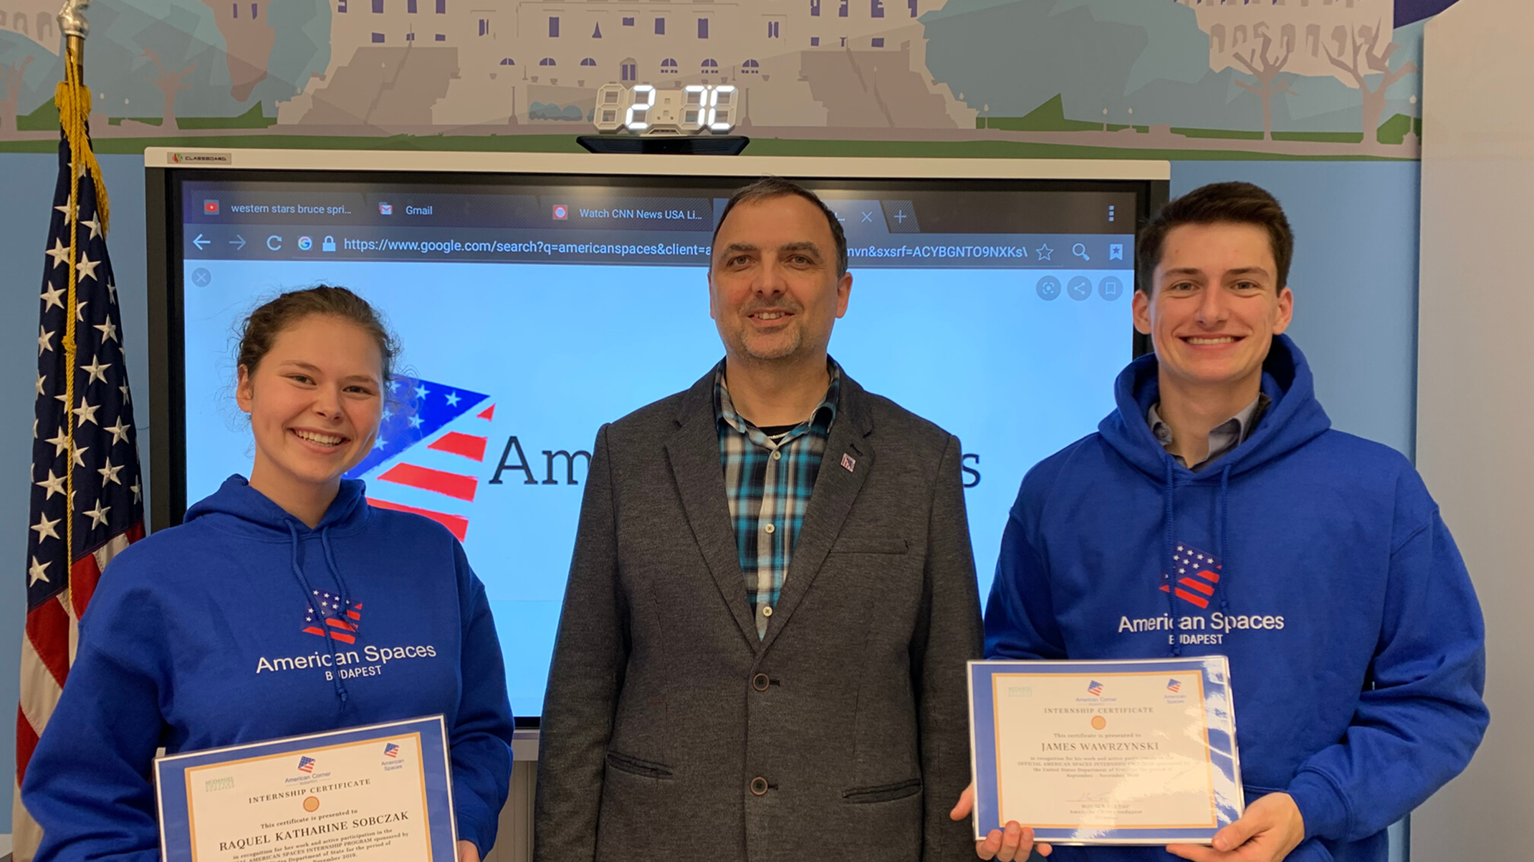
OFFICIAL AMERICAN SPACES INTERNSHIP PROGRAM
American Corner Budapest is a host institute for American Interns, who actively participate in our event both as presenters as well as organizers

Slide 13
CONNECT WITH US
E-MAIL
Facebook
If you have any questions or concerns, please contact us via the following email addresses:
Ferenc Maurer (director):
budapestach@gmail.com
Dóra Gebefügi
(program coordinator):
dora.gebefugi.ach@gmail.com
You can find out about our events by following us on Facebook, where we update our followers regularly about our activities. Our programs are always posted to Facebook as "events" within which you can find the registration link for each program.
FOLLOW US: @AMERICANCORNERBUDAPEST

Slide 14
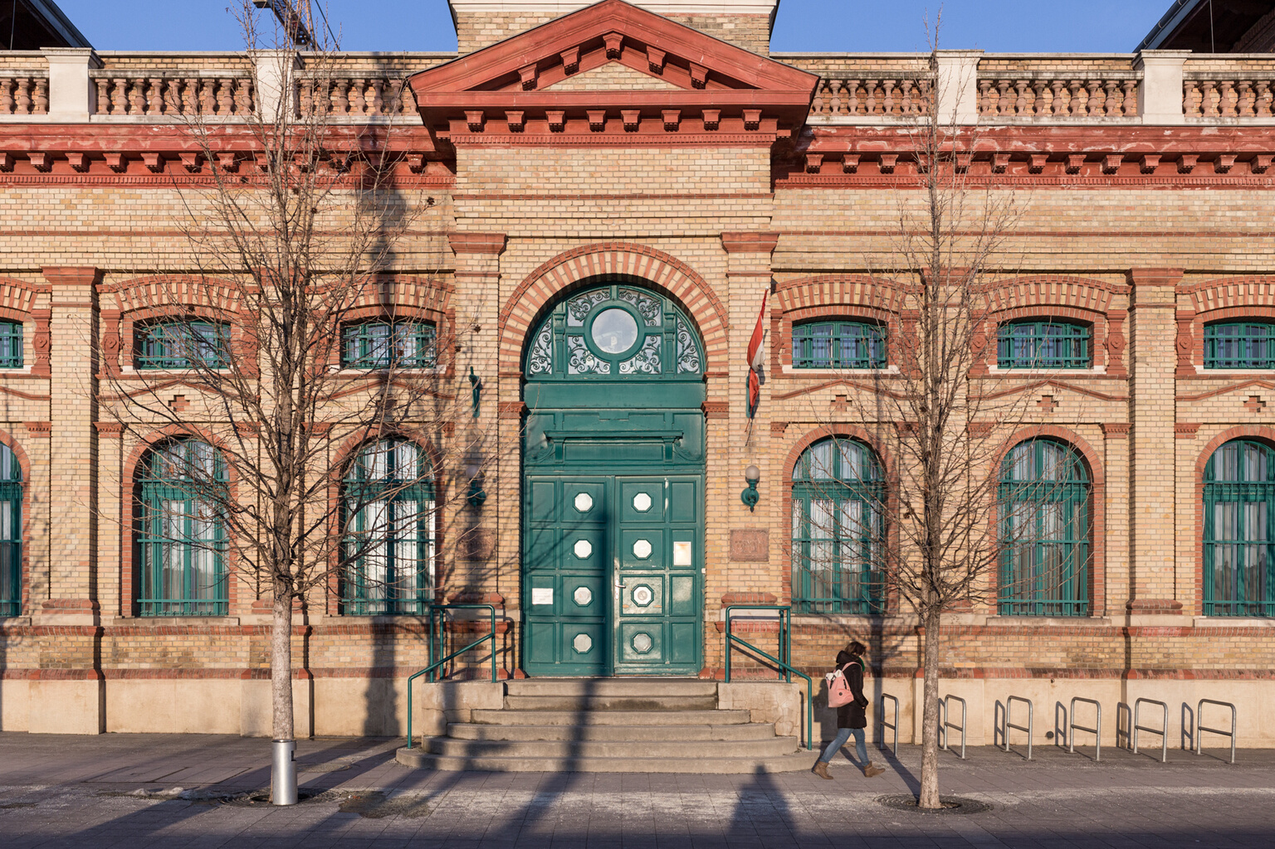
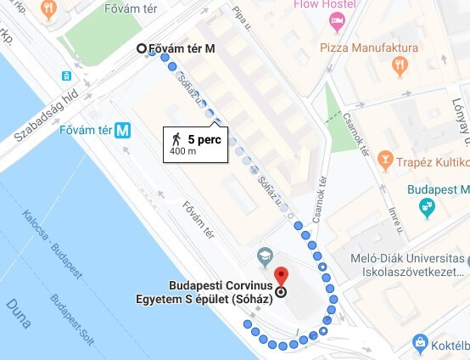
FIND US
IN BUDAPEST
CORVINUS UNIVERSITY OF BUDAPEST
1093 BUDAPEST, FŐVÁM TÉR 13-15.
SÓHÁZ (S ÉPÜLET)
ONLY A 5 MINUTE WALK FROM FŐVÁMTÉR!

